Slide 1
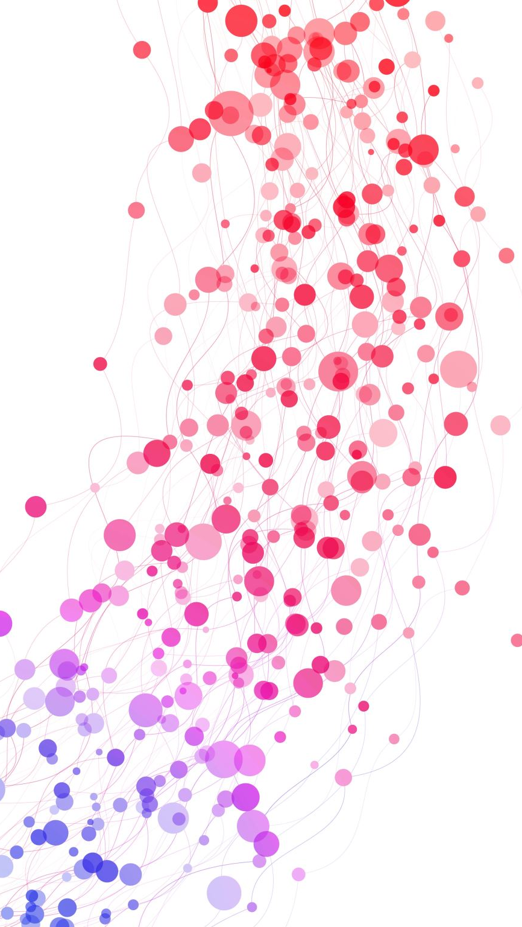
Agile vs Waterfall methodology
By: Mitchell Fitzsimmons

Slide 2
Waterfall Method
A step by step method that is linear in nature
Harder to change or pivot functions and features
A non dynamic method with a fixed project time, typically short
Given it’s linear nature, there are no ambiguous requirements

Slide 3
Agile Method
Prioritizes functions and features based on length and difficulty
More dynamic and susceptible to pivots and changes
Allows for time frame changes as backlogs and user stories are updated

Slide 4
Agile Vs Waterfall
Agile is more dynamic in nature due to its prioritization on functions and features compared to waterfall’s linear method
Agile is more flexible as it can pivot easily to the constant real time updates of backlogs and user stories
Agile can be more ambiguous with not much information compared to waterfall’s linear structure

Slide 5

References
Waterfall Methodology. (2022, December 15). ProjectManager. https://www.projectmanager.com/guides/waterfall-methodology#:~:text=The%20waterfall%20methodology%20is%20a%20linear%20project%20management,the%20next%2C%20following%20steadily%20down%20like%20a%20waterfall.
A. (n.d.). What Is Agile Methodology? (A Beginner’s Guide) [2023] • Asana. Asana. https://asana.com/resources/agile-methodology

